Slide 1
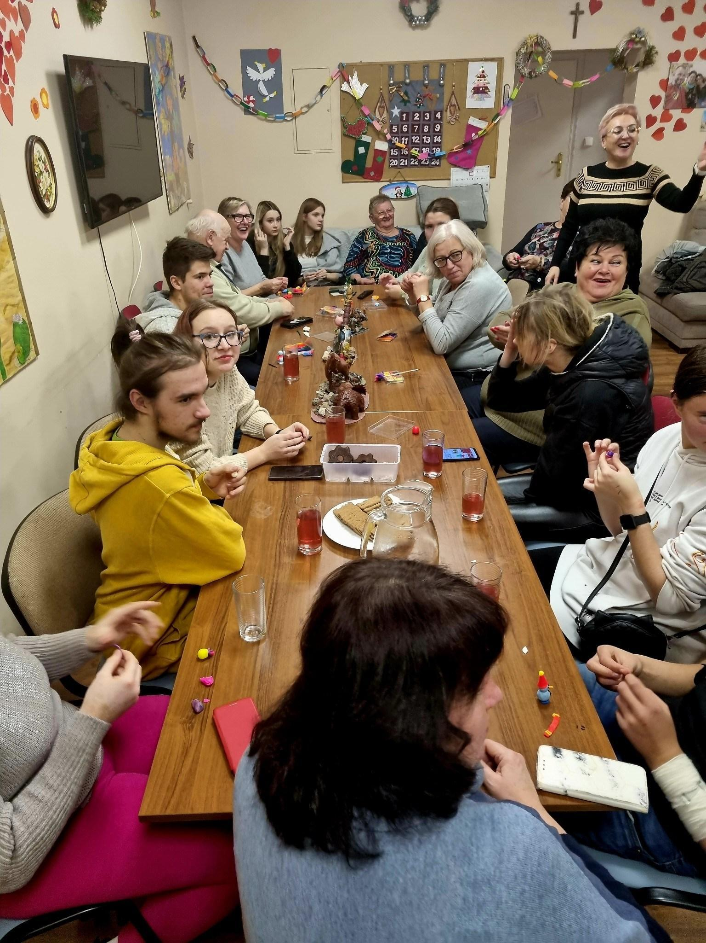
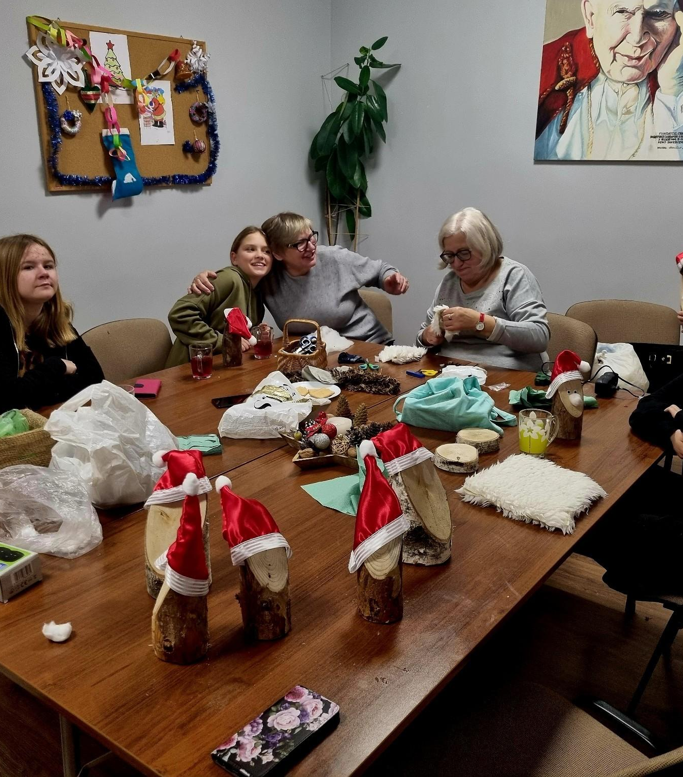
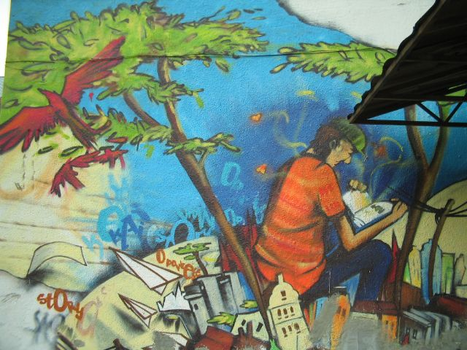

Culture as a Bridge
How “Pomost” builds social integration through culture – and what we propose to create together with VOFO
CyberHeritage – Bridging Cultures through Tradition and Innovation

Slide 2
Our model: integration through culture
Culture gives people who rarely meet a shared, safe reason to be together – and a role in which they are needed.
1
2
3
4
›
›
›
MEET
CREATE
SHOW
BELONG
Open, low-threshold activities: workshops, games, celebrations
Seniors, children, migrants and adults make something together
Exhibitions, books, performances – the community sees their work
New roles: volunteer, mentor, leader – lasting ties
Who takes part: seniors from the Homini Day Care Home, people at risk of social exclusion (Centre of Social Integration), children from the Baja Land club, young refugees from Ukraine, volunteers and local schools – in one room, around one shared task.

Slide 3
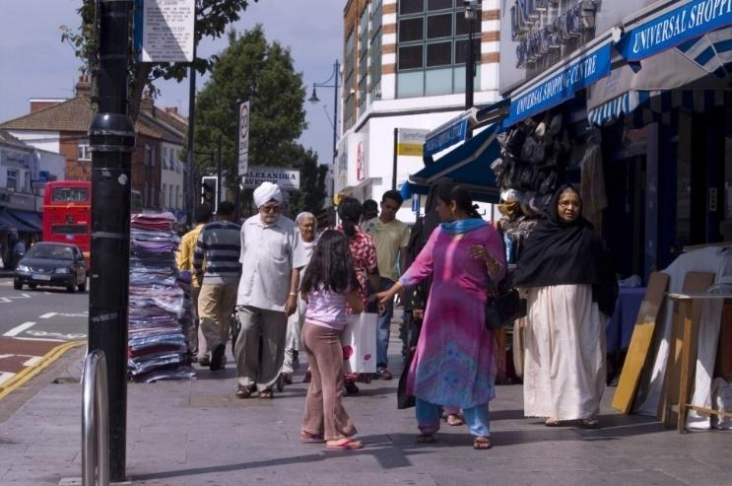
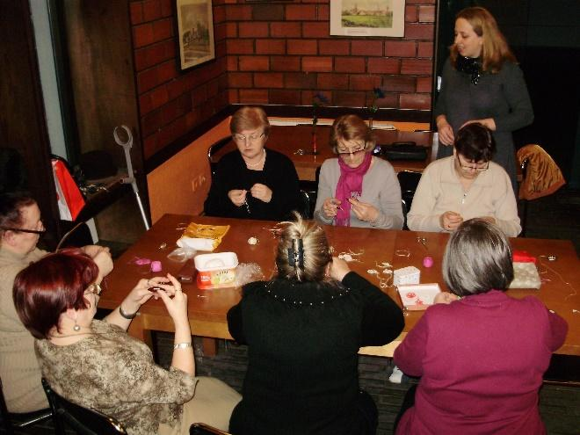
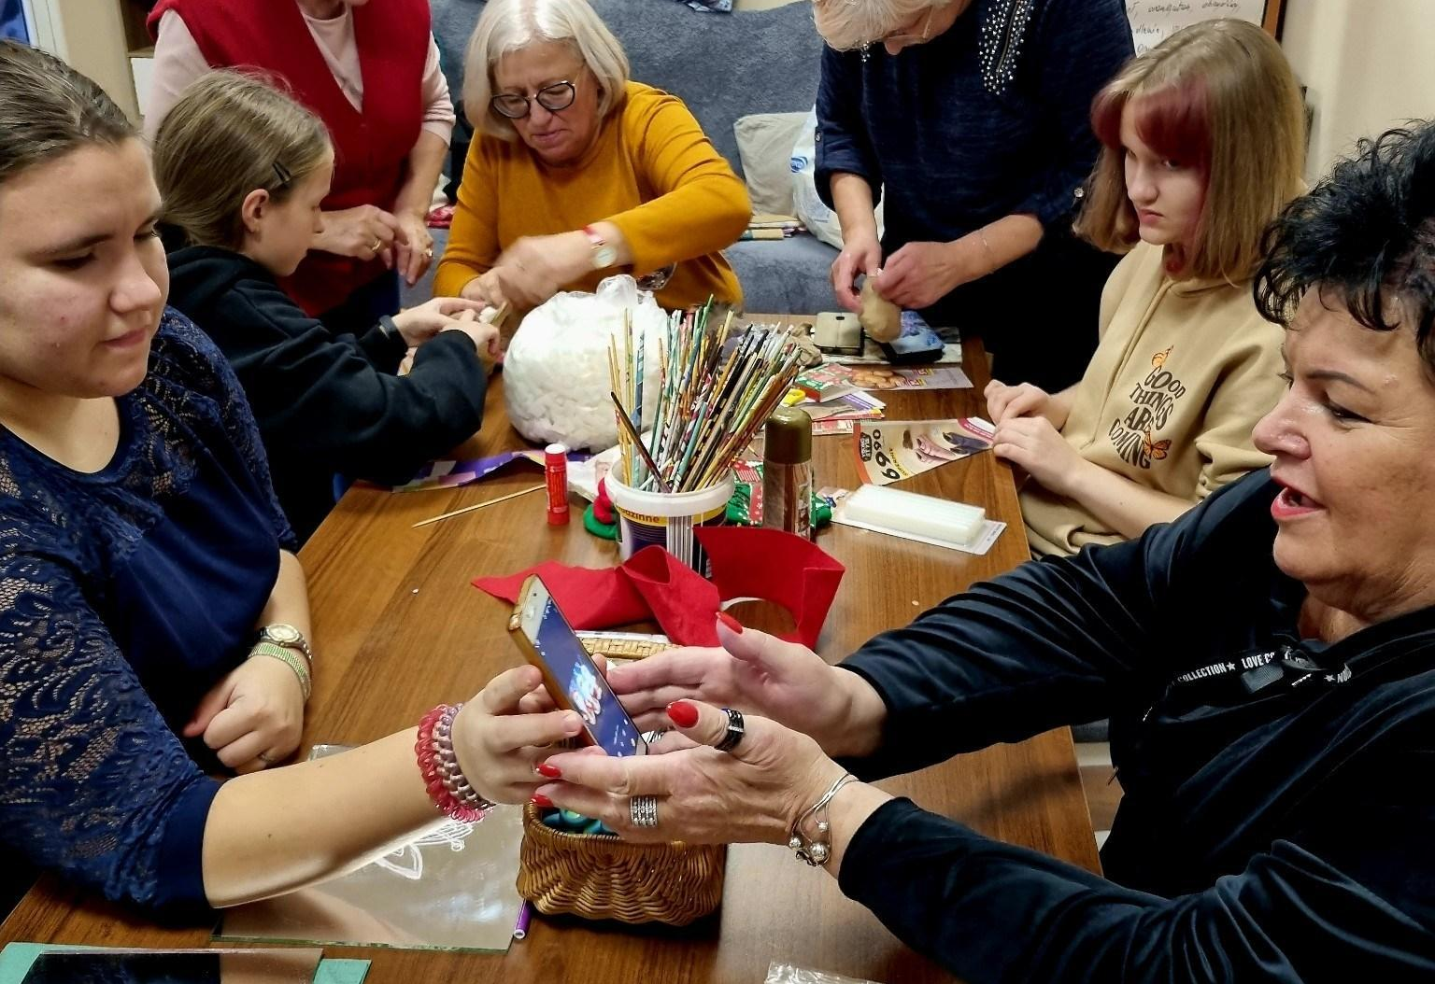
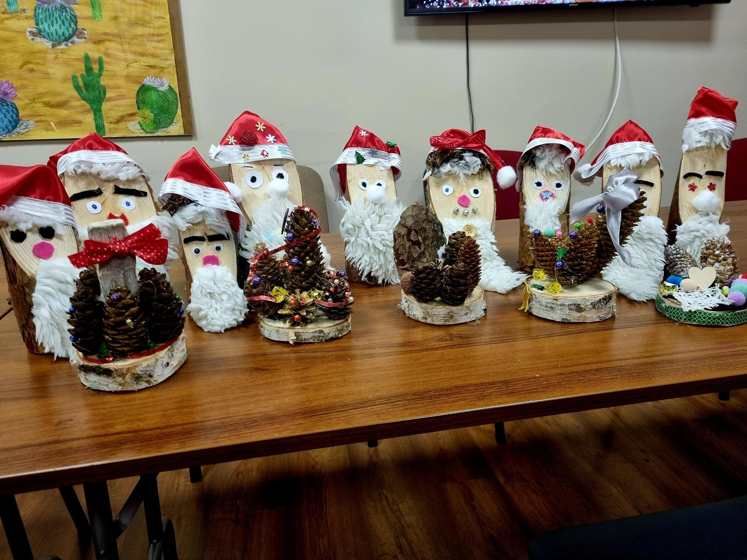

It already works in Świebodzin
Graffiti by Polish and English youth
“Salem Alejkum” – intercultural youth project
Grundtvig – handicrafts of 8 countries
Seniors teach crafts to children
Shared workshops across generations
Book of Memories: “A World Without Cell Phones”

Slide 4


CyberHeritage at a glance
“Pomost” (Poland) + VOFO – Norwegian Association for Adult Learning
200
360 h
participants of all generations
cultural heritage workshops
180 h
1 + 1
digital skills workshops for seniors
handbook and digital platform
Application submitted to the EEA and Norway Grants

Slide 5
Tradition meets innovation
T
Seniors share
I
Young people help
traditional crafts: lace, tatting, ornaments
local stories and family memories
songs, games and recipes
history of Świebodzin and its people
photographing and filming heritage
smartphone and tablet workshops
digital archive on a shared platform
online exhibition Poland – Norway
⇄
Both sides teach – both sides learn.

Slide 6
Two partners, one programme
“Pomost” – Poland
VOFO – Norway
Together
recruits participants from our units
runs heritage and digital workshops
Intergenerational Education Center as the base
exhibitions and events in Świebodzin
know-how in adult and informal learning
study circle method
Norwegian learners and local communities
dissemination in Norway
exchange visits and study meetings
joint handbook and digital platform
monitoring and evaluation
promotion of results in both countries

Slide 7
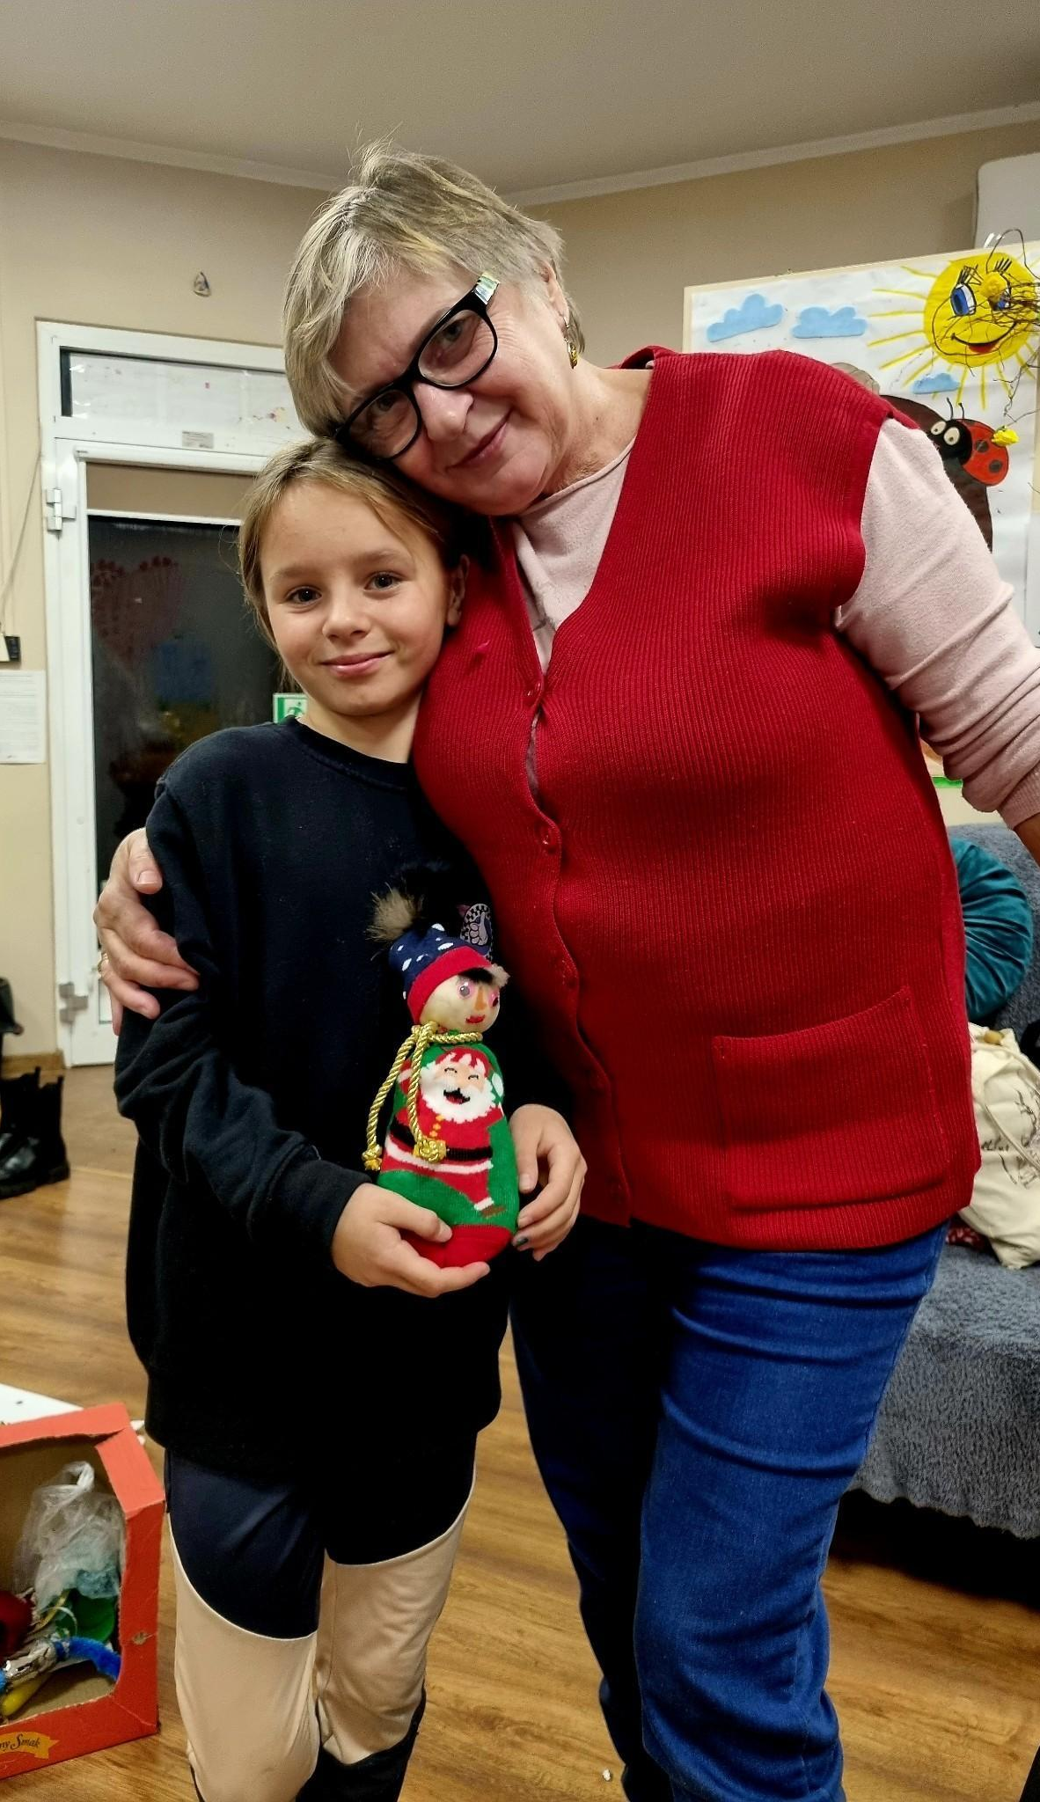
What will stay after the project
✓
Stronger bonds between generations and cultures
✓
Seniors confident with digital tools
✓
Local heritage recorded and available online
✓
A handbook any small town can use
✓
A lasting Polish–Norwegian partnership

Slide 8
Let’s build it together
Small towns need impulses to grow. Culture is the one that reaches everyone.
Thank you for your attention
Jan Kostyszak, Chairman
Małgorzata Jażdżewska, CEO
naszpomost.pl · stowarzyszenie@naszpomost.pl

